Slide 1
AKMM – The Modelling Process
Modelling
Model
Initial Metamodel
Metamodel

Slide 2
AKMM – The Modelling Process
Type Definition Model
Generate metamodel
Modelling
Initial Metamodel
Metamodel
New Metamodel

Slide 3
AKMM – The Modelling Process
Type Definition Model
Generate metamodel
Modelling
Another New Metamodel
Type Definition Model
Generate metamodel
Modelling
New Metamodel
Metamodel

Slide 4
AKMM – The Modelling Process
Model
GraphQL
Generate API
Type Definition Model
Generate metamodel
Modelling
Initial Metamodel
Metamodel
New Metamodel

Slide 5
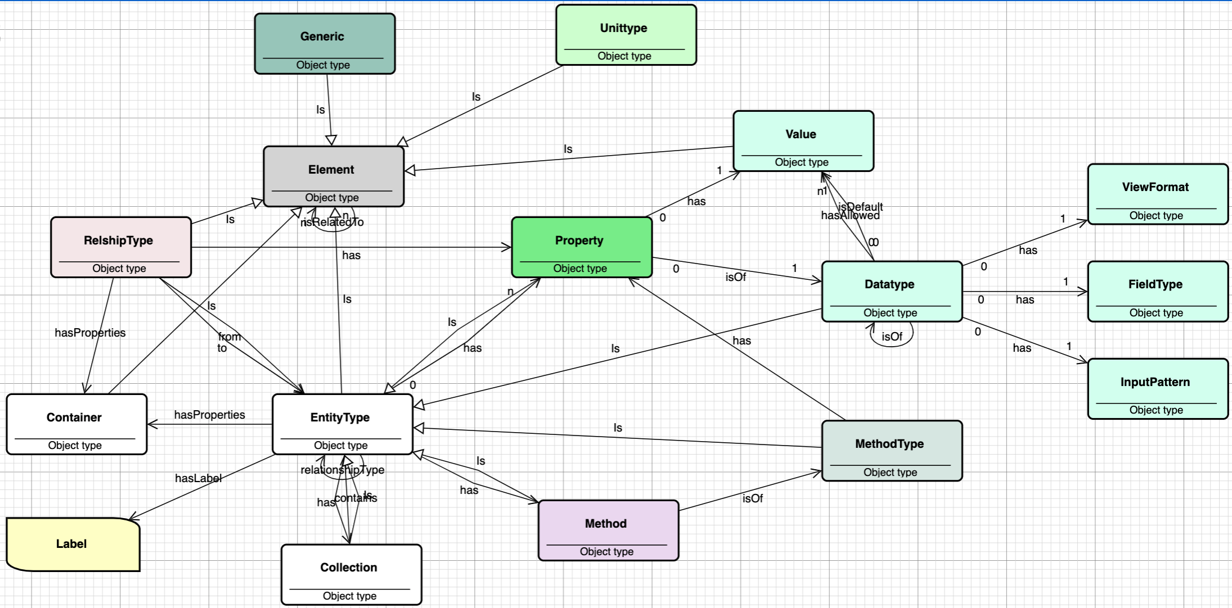
Inital Metamodel

Slide 6
Importing OSDU data definitions into AKMM
Import and postprocess
OSDU Data Definitions
(«Metamodel»)
json files
AKMM
OSDU Metamodel
json files

